Slide 3
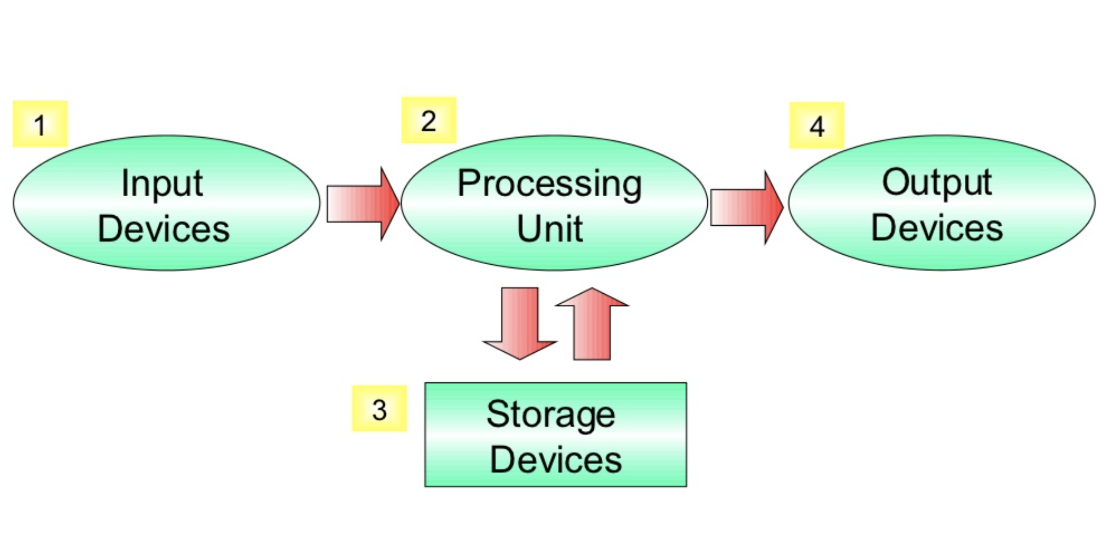

Slide 5


Slide 6
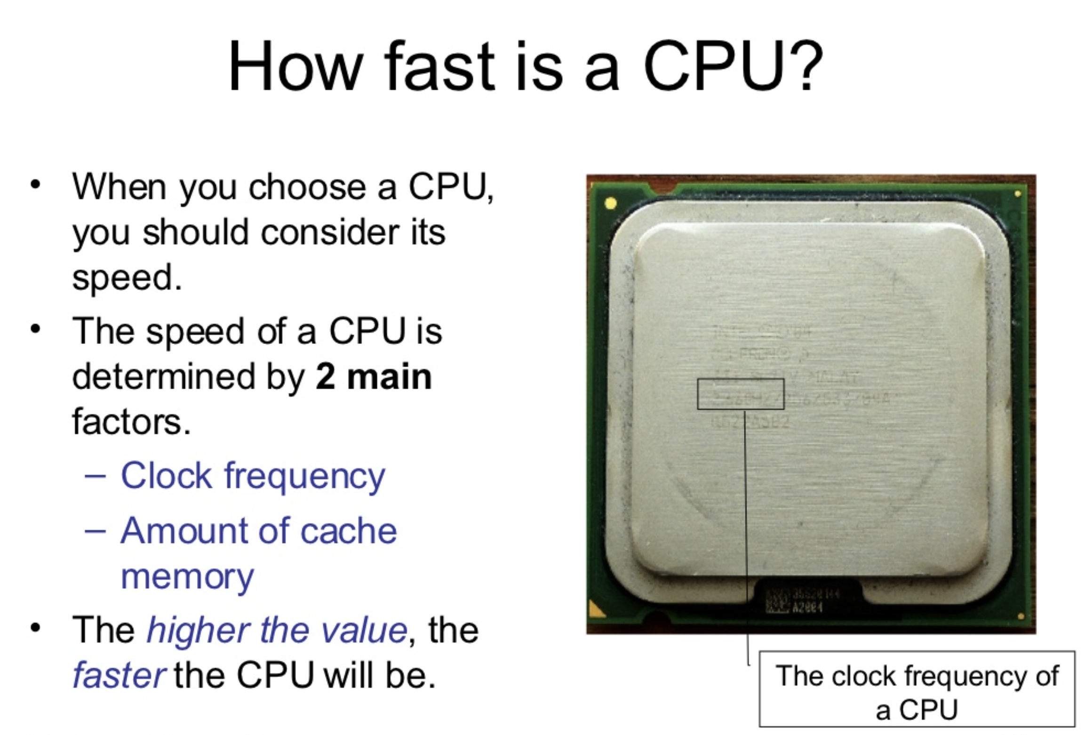
Measured in Hz (GHz)

Slide 8
Measured in bytes (MB, GB)

Slide 9
